Slide 1
Human Action Recognition
Group-11
Vivek Sai Gujja Ajith Gannamaneni Abhinav Botla Sumanth Para

Slide 2
Introduction
The Human Action Recognition project is a web application designed to recognize human actions in a video using machine learning model.
The aim of this project is to provide a user-friendly web application that can recognize human actions in a video.
The application allows users to upload a video from their local system over the cloud and receive the predicted action as a label.
The tech stack used in this project includes Nodejs and Express for the front-end, and Python Flask for the back-end.
In this presentation, we will discuss the method used to recognize human actions, the challenges we faced during deployment, and the solutions we found.

Slide 3
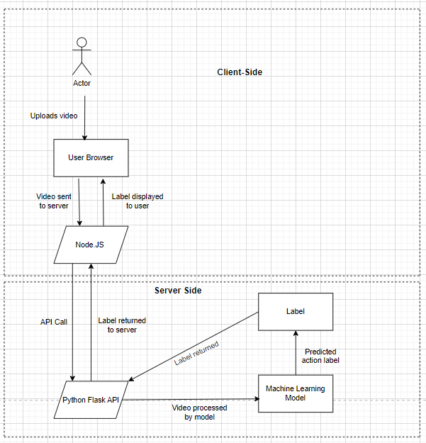
Application Workflow

Slide 4
Requirements
Python 3.10
OpenCV
Flask
Gdown
Node js
Express
Resnet kinetics model
Internet Browser

Slide 5
Tech Stack
Node.js is used for handling the user interface and creating the server-side logic.
Express provides a simple and easy-to-use framework for creating server-side applications.
Python Flask is used for processing video files and making requests to the machine learning model.
The machine learning model is trained using a convolutional neural network (CNN) and utilizes transfer learning to improve accuracy.
The UCF101 dataset contains videos of 101 different human actions, which were used to train the machine learning model.
Splitting video into image blobs using OpenCV's cv2 library.
The model achieves an accuracy of 85% on the UCF101 dataset, which makes it suitable for predicting human actions in real-world scenarios.

Slide 6
Deployment
Node.js application was deployed on Heroku cloud using the command line interface
Python Flask was deployed on AWS EC2(t2.medium)
Heroku was chosen for deploying the Node.js application due to its ease of use and quick deployment process
AWS EC2 was chosen for deploying the Flask application due to its scalability and flexibility
Both deployments were successful and the web application is now live and accessible to users.

Slide 7
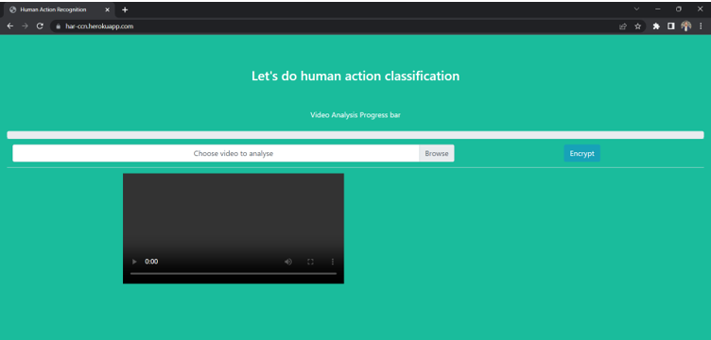
User Interface

Slide 8
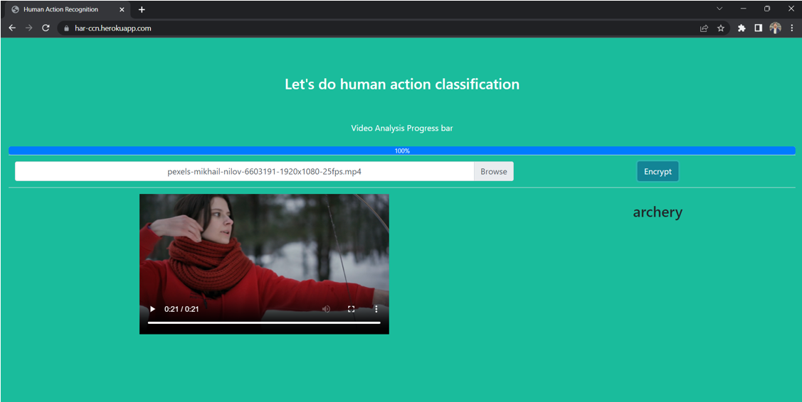
Action Identification

Slide 9
Challenges Faced
Tried deploying flask application onto different cloud platforms like Streamlit, Digital Ocean, Heroku, and Google Cloud App
Faced issues with each platform during the process
Streamlit: faced python version incompatibility issues
Heroku: maximum upload size of 500mb, which was not sufficient for our model
Read only issue in Google App Engine.
AWS Elastic Beanstalk: faced issues with S3 and EC2 instance triggering
Manually triggered the EC2 instance and pushed the code, which is now successfully running.

Slide 10
Thank you!!

